Slide 1
Machine Learning CS F464
Dr. Pranav M. Pawar

Slide 2
Contents
Instance based Classifier
K-nearest Neighbour
Case based reasoning

Slide 3
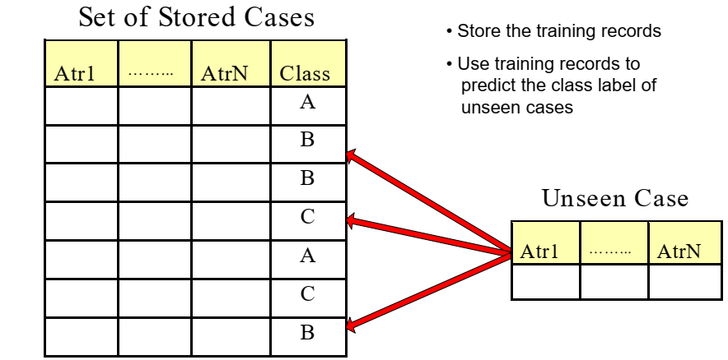
Instance based Classifier (1)

Slide 4
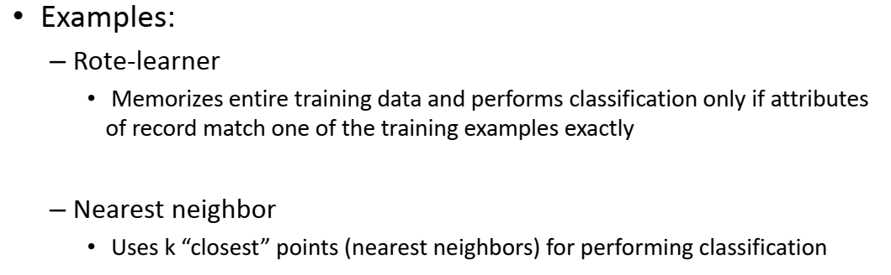
Instance based Classifier (2)

Slide 5
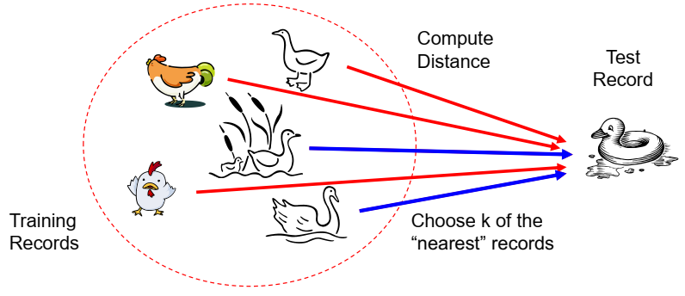
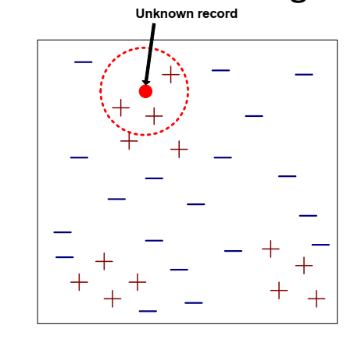
K- nearest Neighbour Classifier (1)
Basic idea
If it walks like a duck,
quacks like a duck,
then it’s probably a duck.
Requires three things
The set of stored records
Distance Metric to compute distance between records
The value of k, the number of nearest neighbours to retrieve
To classify an unknown record:
Compute distance to other training records
Identify k nearest neighbours
Use class labels of nearest neighbours to determine the class label of unknown record (e.g., by taking majority vote)

Slide 6
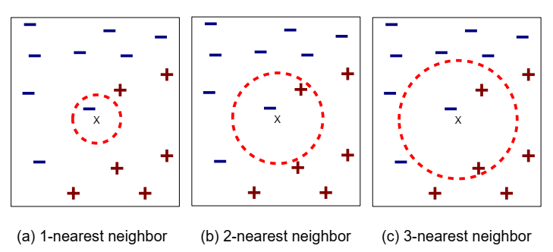
K- nearest Neighbour Classifier (2)
K-nearest neighbours of a record x are data points that have the k smallest distance to x

Slide 7
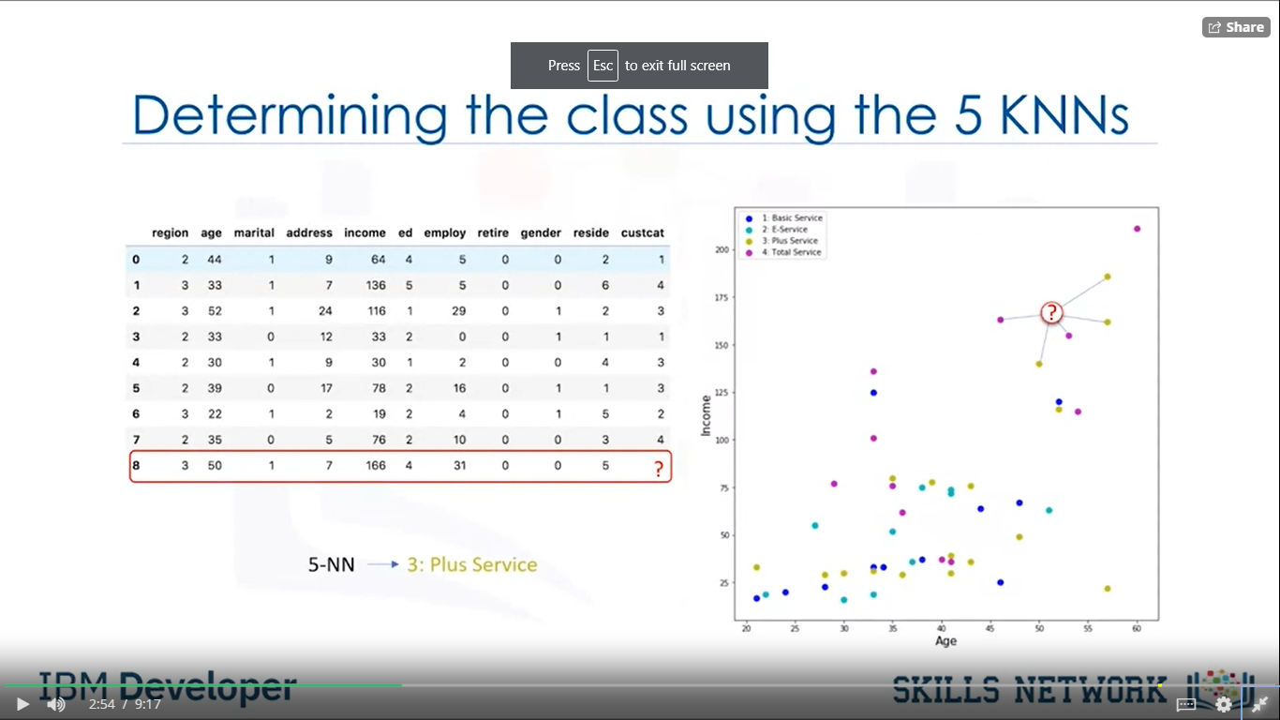
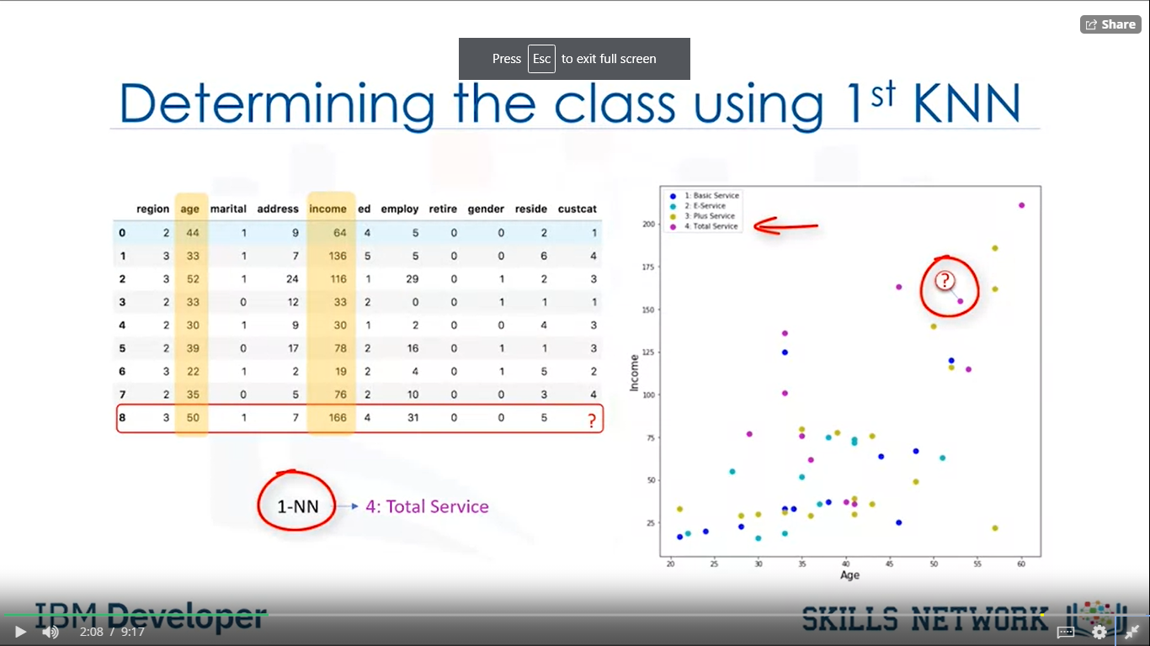
K-Nearest Neighbour Classifier (2)
A method for classifying cases based on their similarity to other cases.
Cases that are near to each other are said to be neighbours.
Based on similar cases with same class labels are near to each other.

Slide 8
KNN Algorithm
Pick a value of K.
Calculate the distance of unknow case for all cases.
Select the K-observations in the training data that are nearest to the unknown data point.
Predict the response of the unknown data point using the most popular response value from the K-nearest neighbour.

Slide 9
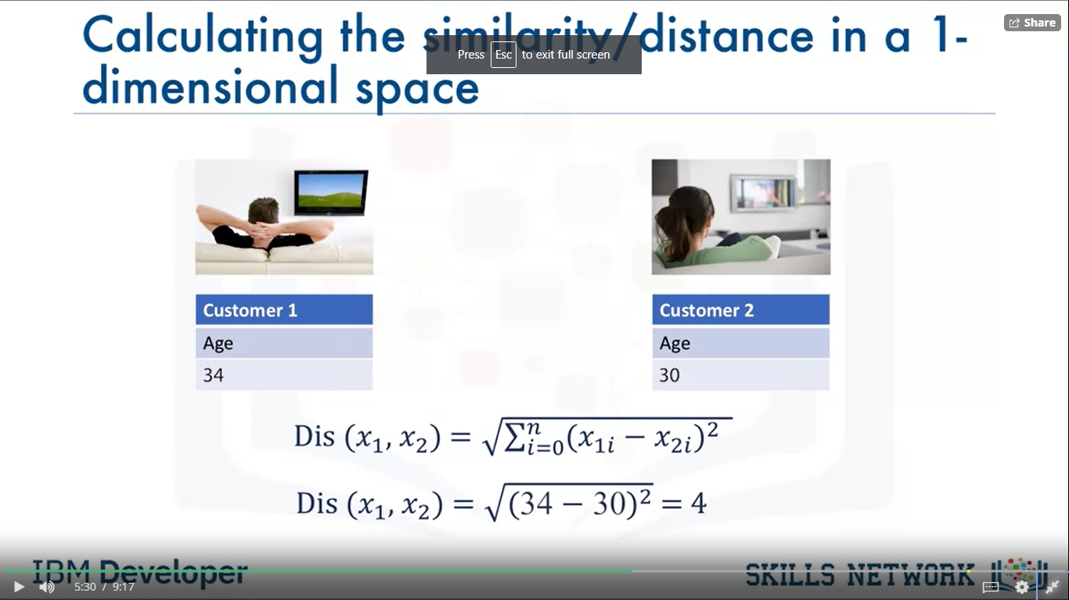
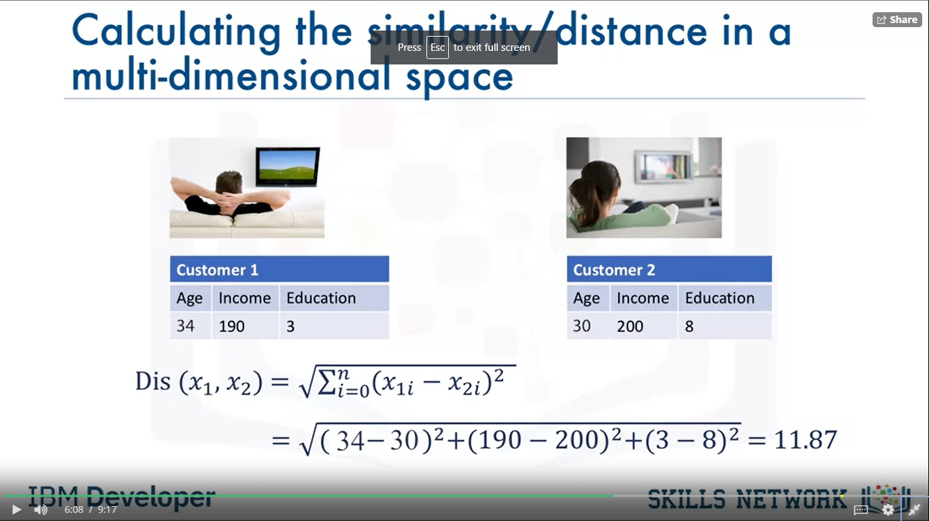
Calculating distance/similarity
In 1 dimensional space
In multi-dimensional space

Slide 10
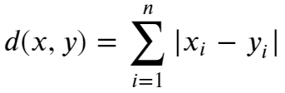
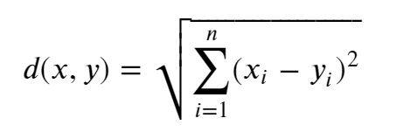
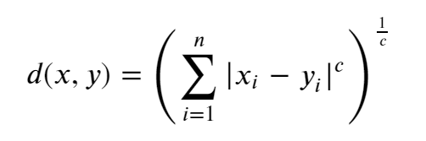
Common Distance Measures
Manhattan Distance
Euclidian Distance
Makowski distance

Slide 11
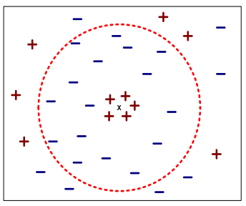
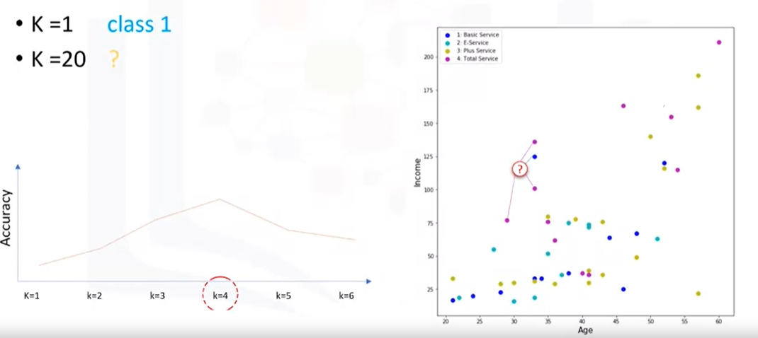
Choosing value of K
Choosing the value of k,
If k is too small, sensitive to noise points
If k is too large, neighbourhood may include points from other classes

Slide 12
Advantages and Disadvantages
Advantages
No training period: Because data itself is model.
Easy to implement
New data can be added any time
Work with any number of classes not just binary classifiers.
Disadvantages
Does not work well with large dataset
Does not work well with high dimensionality
Sensitive to noisy and missing data
Attributes may have to be scaled to prevent distance measures from being dominated by one of the attributes.
It is lazy learner
It does not build models explicitly
Unlike eager learners such as decision tree induction and rule-based systems
Classifying unknown records are relatively expensive

Slide 13
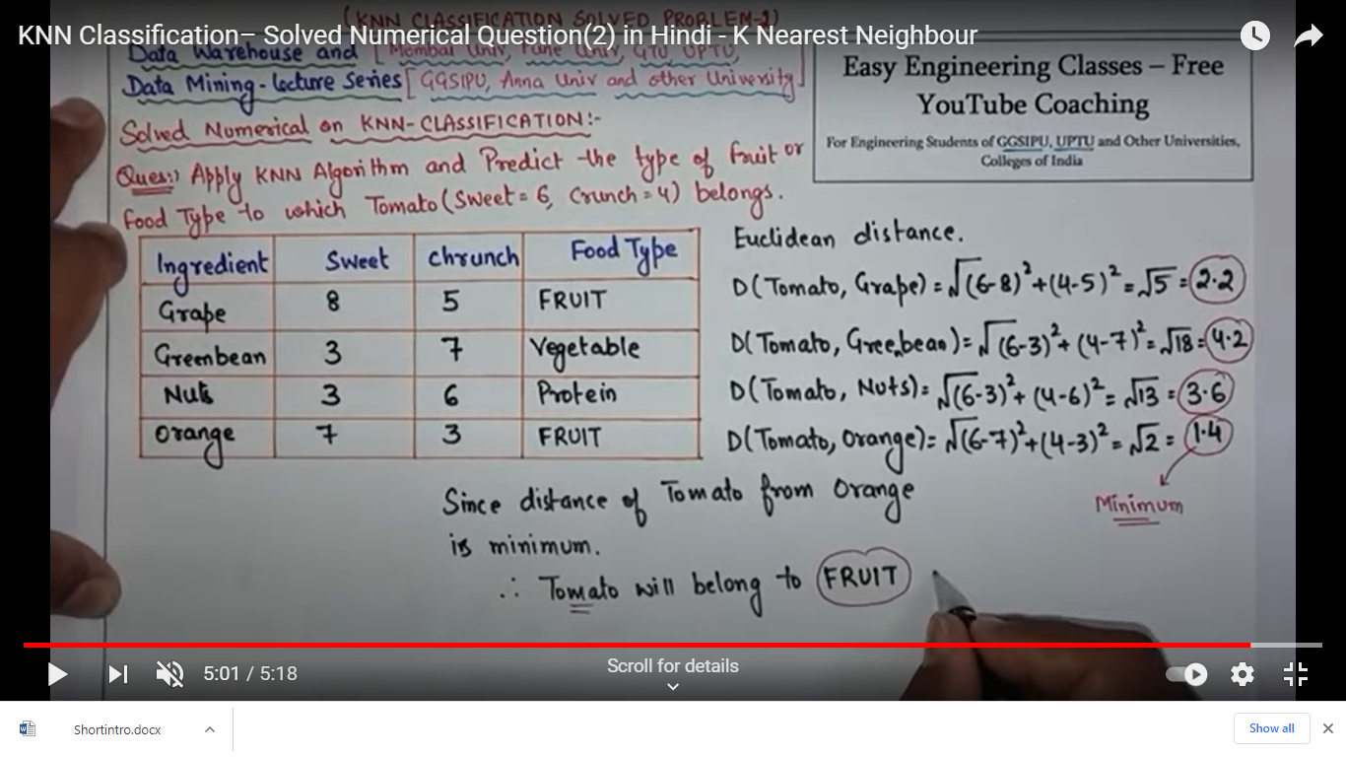
KNN Example 1

Slide 14
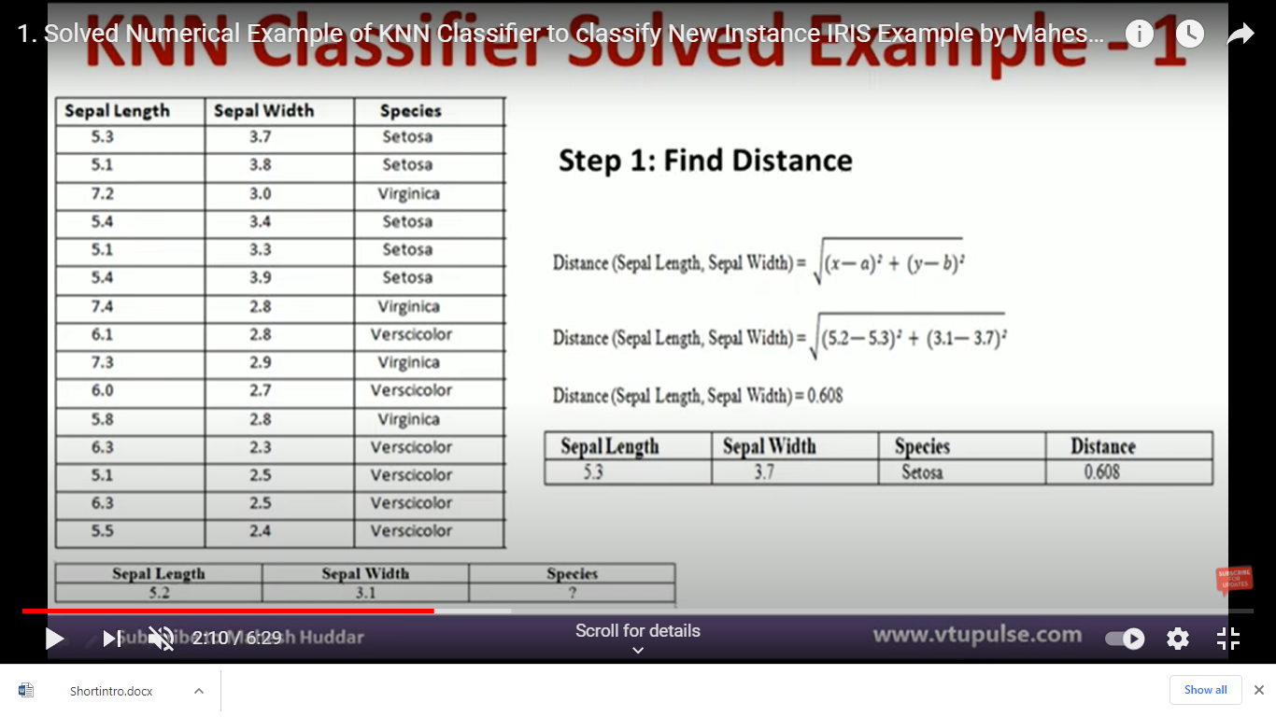

Slide 15
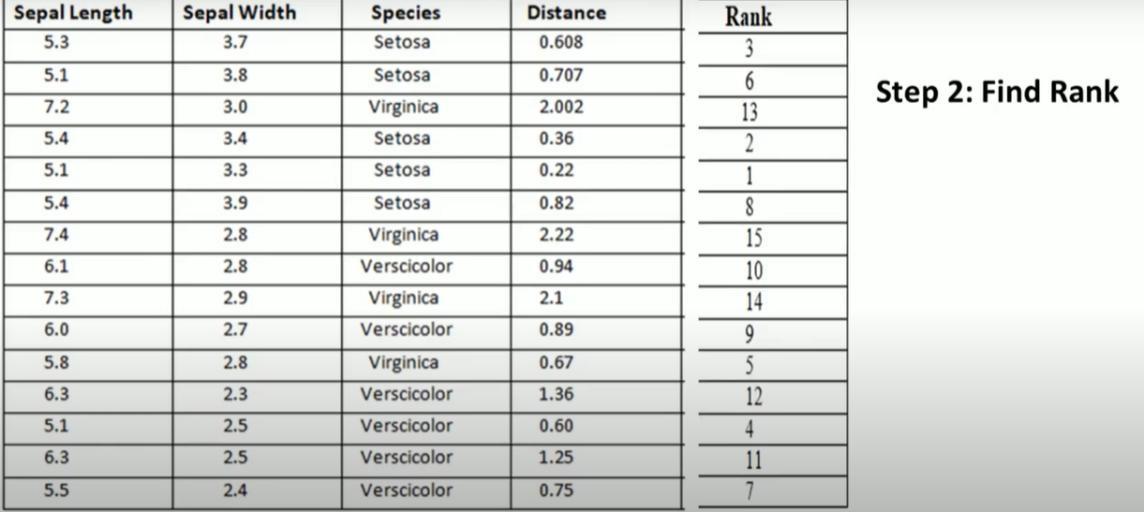

Slide 16
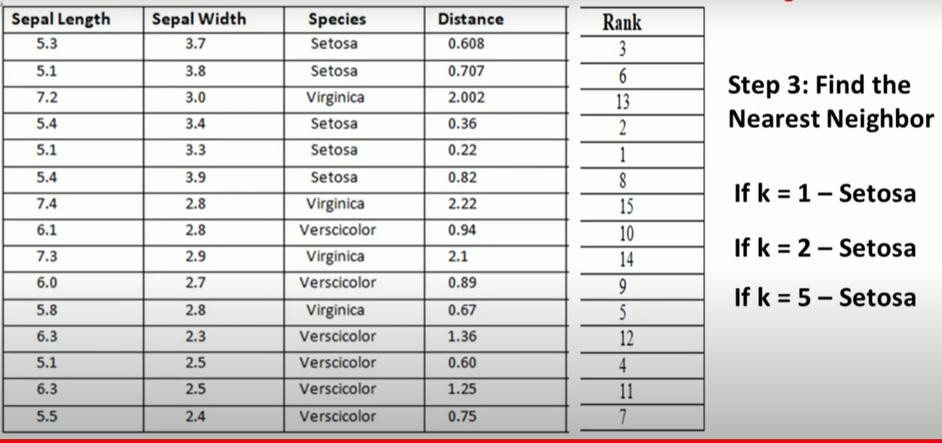

Slide 17
Case Based Reasoning (1)
Case-Based Reasoning (CBR) is a name given to a reasoning method that uses specific past experiences rather than a corpus of general knowledge.
It is a form of problem solving by analogy in which a new problem is solved by recognizing its similarity to a specific known problem, then transferring the solution of the known problem to the new one.
CBR systems consult their memory of previous episodes to help address their current task, which could be:
planning of a meal,
classifying the disease of a patient,
designing a circuit, etc.

Slide 18
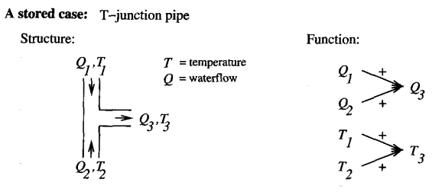
Case Based Reasoning (2)
Use rich symbolic description.
Application
Design of mechanical devices based on a stored library of previous designs.
New legal cases based on previous rulings.
Solving planning and scheduling problems by reusing and combining portions of previous solutions to similar problems.
And many more.
Example: CADET System
Used for designing new mechanical component based on stored design

Slide 19
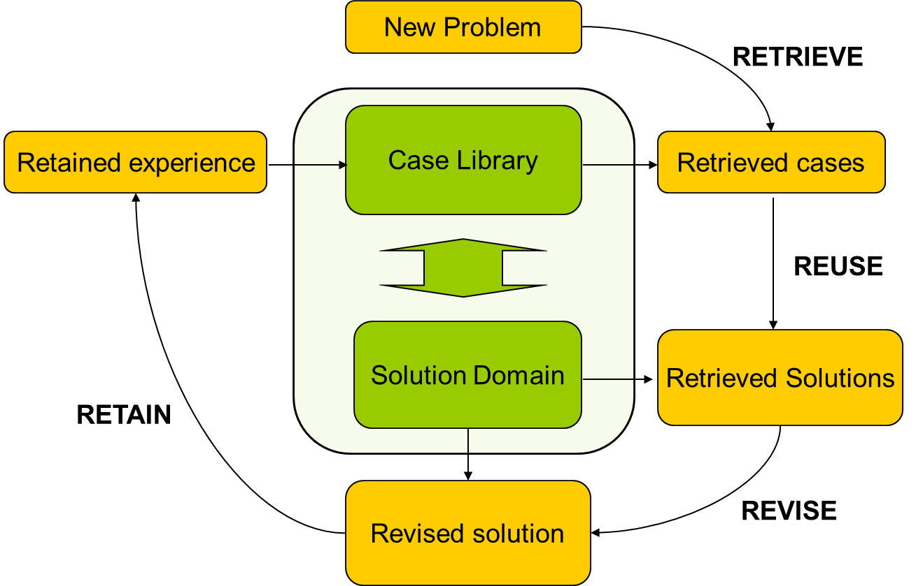
Case Based Reasoning (3)
Architecture

Slide 20
Sources
Chapter 8, Christopher M Bishop: Pattern Recognition & Machine Leaning, 2006 Springer.
“Machine learning with Python course”, IBM.
https://www.csd.uwo.ca/~oveksler/Courses/CS434a_541a/
https://data-flair.training/blogs/svm-kernel-functions
http://axon.cs.byu.edu/Dan/678/miscellaneous/SVM.example.pdf
https://web.iitd.ac.in/~bspanda/KNN%20presentation.pdf
https://www.youtube.com/watch?v=Vk9lGGODaJA
https://www.youtube.com/watch?v=3EQw8awLQJ4
http://people.cs.ksu.edu/~hankley/d764/Slides07/Chou_Reasoning.ppt

Slide 21
Thank You!

